Slide 1
CPT-S 415
Big Data
Yinghui Wu
EME B45

Slide 2
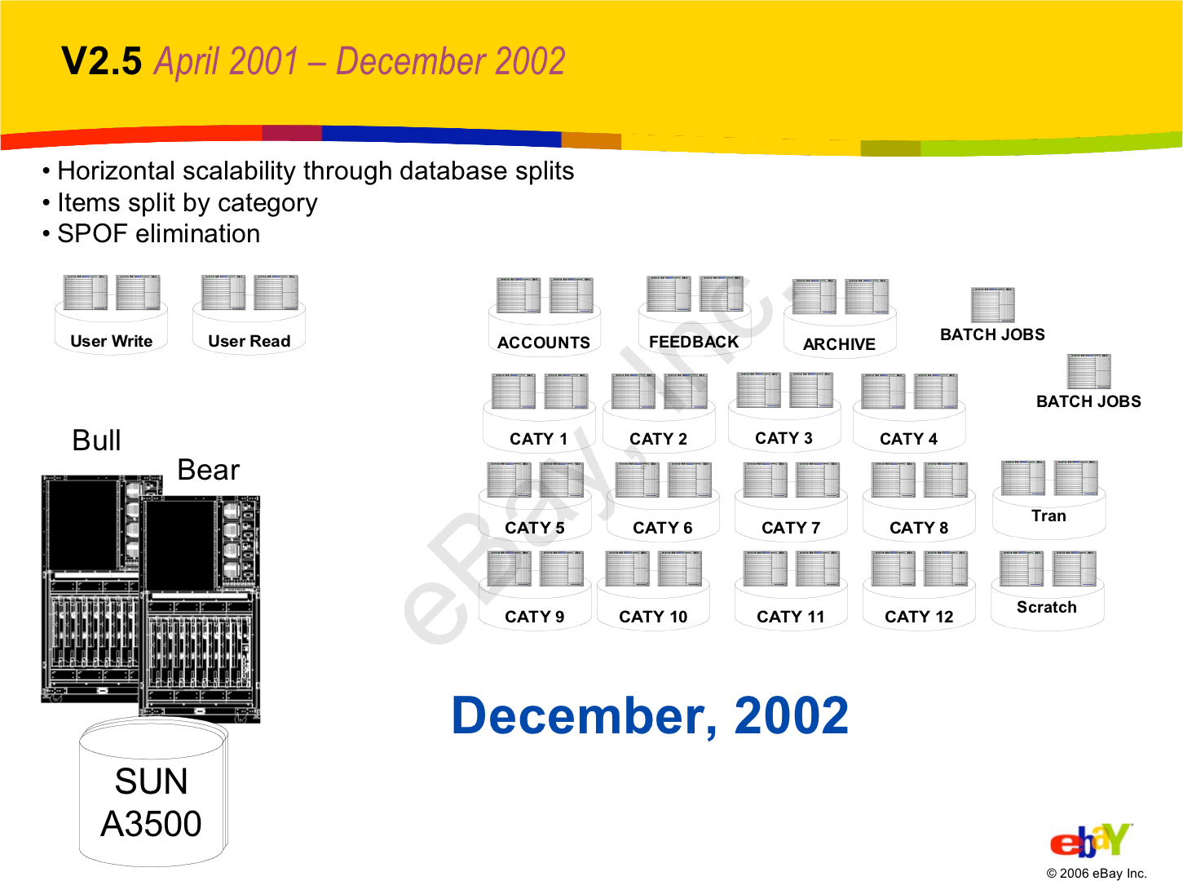
Let’s go back to Early-2000s…
All the big players were heavyweight and expensive.
  Oracle, DB2, Sybase, SQL Server, etc.
Open-source databases were missing important features.
  Postgres, mSQL, and MySQL.

Slide 3
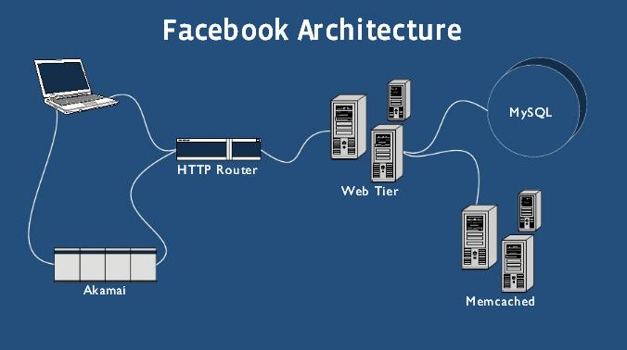
Mid-2000s
MySQL + InnoDB is widely adopted by new web companies:
  Supported transactions, replication, recovery.
  Still must use custom middleware to scale out across multiple machines.
  Memcache for caching queries.

Slide 4
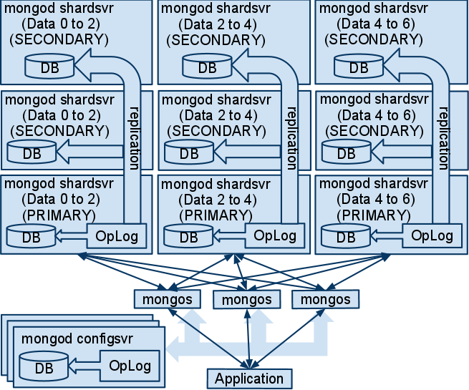
Late-2000s
NoSQL systems are able to scale horizontally:
  Schemaless.
  Using custom APIs instead of SQL.
  Not ACID (i.e., eventual consistency)
  Many are based on Google’s BigTable or Amazon’s Dynamo systems.

Slide 5
















Early-2010s
New DBMSs that can scale across multiple machines natively and provide ACID guarantees.
  MySQL Middleware
  Brand New Architectures
“New SQL”

Slide 6
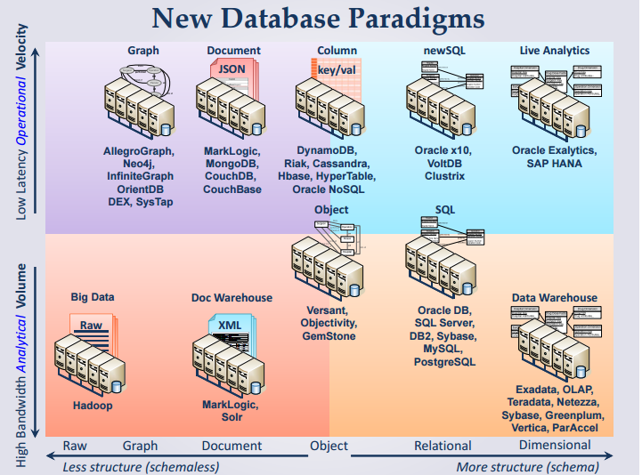
newSQL

Slide 7
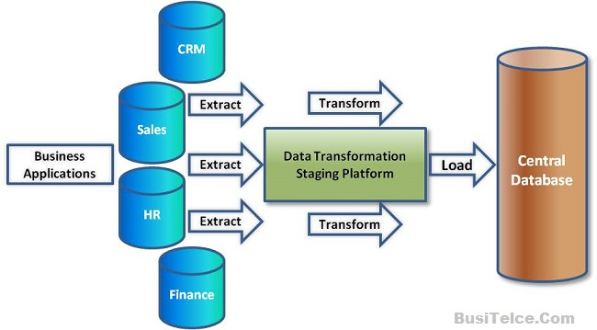
old OLTP and old SQL
An information system can be transactional (OLTP) or/and analytical (OLAP)
OLTP (On-line Transaction Processing): a large number of short on-line transactions (INSERT, UPDATE, DELETE)
  very fast query processing
  data integrity in multi-access environments
  effectiveness measured by number of transactions per second.
schema is used to store transactional databases (usually 3NF).
Old OLTP:
  Collection of OLTP systems
  Connected to ETL (Extract-Transform-and-Load)
  Connected to one or more data warehouses
Old SQL: techs, systems and vendors supporting old OLTP

Slide 8
New requirements (new OLTP)
Web changes everything
Large scale systems, with huge and growing data sets
9M messages per hour in Facebook
50M messages per day in Twitter
Information is frequently generated by devices (cellphones, PDAs, sensors…) -> “Online”
High concurrency requirements, high-throughput ACID write -> “Transaction”
High Availability + Durability: core database requirements
Need for high throughput
Need for real-time analytics

Slide 9
Challenge
Ingest the firehose in real time
Process, validate, enrich and respond in Real-time
Real-time analytics
Options:
  Old SQL - Legacy RDBMS vendors
  NoSQL: give up SQL and ACID
  NewSQL: SQL + ACID + new architecture

Slide 10
noSQL
Give up SQL
Give up ACID
  Data accuracy
  Funds transfer
  Integrity constraints
  Multi-record state
noSQL fits
  Non-transactional systems
  Single record transactions that are commutative
noSQL is not a good fit for
  New OLTP: gaming, purchasing, order management, real-time analytical, etc

Slide 11
NewSQL: informal definition
SQL is good
ACID is good
Figure out a way to make oldSQL perform
Make it scale like noSQL
Make it available
“A DBMS that delivers the scalability and flexibility promised by NoSQL while retaining the support for SQL queries and/or ACID, or to improve performance for appropriate workloads.”
-- 451 Group
Notes:
App-devs learn ACID is good in a hard way.

Slide 12
NewSQL: definition
SQL as the primary mechanism for application interaction
ACID support for transactions
A non-locking concurrency control mechanism so real-time reads will not conflict with writes, and thereby cause them to stall.
An architecture providing much higher per-node performance than available from the traditional "elephants"
A scale-out, shared-nothing architecture, capable of running on a large number of nodes without bottlenecking
  Michael Stonebraker

Slide 13
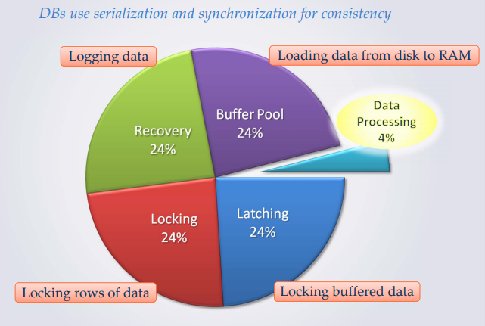
Traditional DBMS overheads
“Removing those overheads and running the database in main memory would yield orders of magnitude improvements in database performance”
Notes:
Death by a thousand paper cut.

Slide 14
NewSQL design principles
SQL + ACID + performance and scalability through modern innovative software architecture
Principle 1: minimizing or stay away from locking
Principle 2: rely on main memory
Principle 3: try to avoid latching
Principle 4: cheaper solutions for HA

Slide 15
NewSQL design principles
new solution other than low-level record level locking mechanism
  Transaction processed in timestamp order with no locking (voltDB)
  multisession concurrency control (nuoDB)
  Optimistic concurrency control (Google)
  Principle: minimizing or stay away from locking

Slide 16
NewSQL design principles
new solution for buffer pool overhead
  Main memory DBMS
  Moderate case is tilted towards main memory
  Principle 2: rely on main memory
new solution to latching for shared data structures
  new way to manage B-trees
  Single-threading
  Principle 3: try to avoid latching
new solution for write-ahead logging
  Built-in replication
  Principle 4: cheaper solutions for HA

Slide 17
newSQL databases

Slide 18
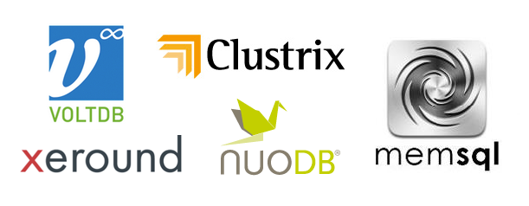

NewSQL: categories
New approaches: VoltDB, Clustrix, NuoDB
New Storage engines: TokuDB, ScaleDB
Transparent Clustering: ScaleBase, dbShards
❖
❖
❖

Slide 19
voltDB

Slide 20
VoltDB
VoltDB is an in-memory, horizontally scalable, ACID compliant, fast RDBMS
Backed and architected by Michael Stonebraker
An open source project
Java + C/++
Available in community and commercial editions

Slide 21
Technical Overview
VoltDB tries to avoid the overhead of traditional databases
  K-safety for fault tolerance
  In memory operation for maximum throughput
  - reduce buffer management
  Partitions operate autonomously and single-threaded
  - no latching or locking
Built to horizontally scale

Slide 22
Technical Overview – Partitions (1/3)
One partition per physical CPU core
  Each physical server has multiple VoltDB partitions
Data - Two types of tables
  Partitioned
    Single column serves as partitioning key
    Rows are spread across all VoltDB partitions by partition column
    Transactional data (high frequency of modification)
  Replicated
    All rows exist within all VoltDB partitions
    Relatively static data (low frequency of modification)
Code - Two types of work – both ACID
  Single-Partition
    All insert/update/delete operations within single partition
    Majority of transactional workload
  Multi-Partition
    CRUD against partitioned tables across multiple partitions
    Insert/update/delete on replicated tables
X
X
X
X
X

Slide 23
Technical Overview – Partitions (2/3)
Single-partition vs. Multi-partition
select count(*) from orders where customer_id = 5 single-partition
select count(*) from orders where product_id = 3
multi-partition
insert into orders (customer_id, order_id, product_id) values (3,303,2)
single-partition
update products set product_name = ‘spork’ where product_id = 3
multi-partition
Partition 1
Partition 2
Partition 3
1 101 2
1 101 3
4 401 2
2 201 1
5 501 3
5 502 2
3 201 1
6 601 1
6 601 2
table orders : customer_id (partition key)
(partitioned) order_id
product_id
1 knife
2 spoon
3 fork
1 knife
2 spoon
3 fork
1 knife
2 spoon
3 fork
table products : product_id
(replicated) product_name

Slide 24

Technical Overview – Partitions (3/3)
Looking inside a VoltDB partition…
  Each partition contains data and an execution engine.
  The execution engine contains a queue for transaction requests.
  Requests are executed sequentially (single threaded).
Work
Queue
execution engine
Table Data
Index Data
- Complete copy of all replicated tables
- Portion of rows (about 1/partitions) of all partitioned tables

Slide 25
Technical Overview – Compiling
Schema
Stored Procedures
The database is constructed from
  The schema (DDL)
  The work load (Java stored procedures)
  The Project (users, groups, partitioning)
VoltCompiler creates application catalog
  Copy to servers along with 1 .jar and 1 .so
  Start servers
CREATE TABLE HELLOWORLD (
HELLO CHAR(15),
WORLD CHAR(15),
DIALECT CHAR(15),
PRIMARY KEY (DIALECT)
);
import org.voltdb. * ;
@ProcInfo(
partitionInfo = "HE
singlePartition = t
public final SQLStmt
public VoltTable[] run
import org.voltdb. * ;
@ProcInfo(
partitionInfo = "HELLOWORLD.DIA
singlePartition = true
)
public class Insert extends VoltPr
public final SQLStmt sql =
new SQLStmt("INSERT INTO HELLO
public VoltTable[] run( String hel
import org.voltdb. * ;
@ProcInfo(
partitionInfo = "HELLOWORLD.DIA
singlePartition = true
)
public class Insert extends VoltPr
public final SQLStmt sql =
new SQLStmt("INSERT INTO HELLO
public VoltTable[] run( String hel
Project.xml
<?xml version="1.0"?>
<project>
<database name='data
<schema path='ddl.
<partition table=‘
</database>
</project>

Slide 26
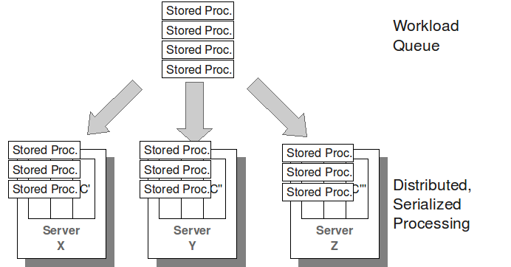
Transaction Model
Procedures routed to, ordered and run at partitions

Slide 27
Transaction Execution
VoltDB Cluster
Single partition transactions
  All data is in one partition
  Each partition operates autonomously
Multi-partition transactions
  One partition distributes and coordinates work plans
Server
1
Partition 1
Partition 2
Partition 3
Server
2
Partition 4
Partition 5
Partition 6
Server
3
Partition 7
Partition 8
Partition 9

Slide 28
Data Availability and Durability
High Availability
  Data stored on server replicas (user configurable)
  Failover data redundancy
  No single point of failure
Database Snapshots
  Simplifies backup/restore
  Scheduled, continuous, on demand
  Cluster-wide consistent copy of all data
Command Logging
  Between Snapshots, every transaction is durable to disk

Slide 29
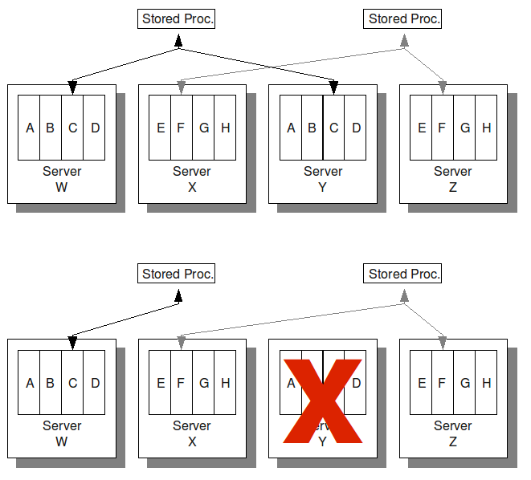
K-safety
Duplicate database partitions for fault tolerance. K: # of replicas

Slide 30
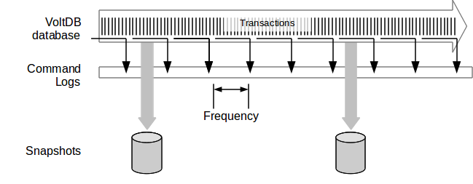
Command Logging
Tunable
frequency
Tunable snapshot interval
Synchronous logging provides highest durability at reduced performance
Asynchronous logging best performance at reduced durability

Slide 31
Disaster Recovery
Disk snapshots replicated via storage system
Stream command logs from Primary to Replica
Run from Replica on DR event, reverse on recovery
Primary Site
Remote Replica Site
(read only)
Snap
Shots
VoltDB
Cluster
VoltDB
Cluster

Slide 32
Lack of concurrency
Single-threaded execution within partitions (single-partition) or across partitions (multi-partition)
No concern about locking/dead-locks
  great for “inventory” type applications
    checking inventory levels
    creating line items for customers
Because of this, transactions execute in microseconds.
However, single-threaded comes at a price
  Other transactions wait for running transaction to complete
  Useful for OLTP, not OLAP

Slide 33
Summary: NewSQL design principles
SQL + ACID + performance and scalability through modern innovative software architecture
Principle 1: minimizing or stay away from locking
Principle 2: rely on main memory
Principle 3: try to avoid latching
Principle 4: cheaper solutions for HA

Slide 34
nuoDB

Slide 35
nuoDB
nuoDB is an elastically scalable, ACID compliant, newSQL Database
Backed and architected by Jim Starkley
Runs on JVM
Proprietary source project

Slide 36


NuoDB: Architecture
Multi-tier Architecture
  Transaction tier
  Storage tier
  Management tier
Multi-Tenant
Heavy use of memory
  hot data stays in memory
  Cold data in persistent store
Object Oriented
  Objects are atoms
Asynchronous Messaging
Partial, On-Demand replication
MVCC - Concurrency
❖
❖
❖
❖

Slide 37
Technical Overview – Tiered Architecture
Tiered Architecture
  Transactions: Transaction Engine
    Parse, compile, optimize and execute SQL commands
    Stores some information in memory locally
    Map to locate the information
    Any transaction engine can service any piece of information regardless of where it resides
    Adding transaction engines -> More throughput
  Storage: Storage manager
    Can run on HDFS or Amazon S3
    Adding storage manager -> more resistance to failure
  Management: Agents and Brokers
    (Re)starting transaction engines and storage managers
    Collect statistics from them
    Clients connect to TE via Brokers

Slide 38
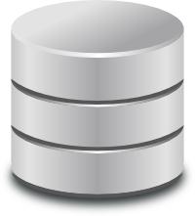
Multi-tier architecture
Management
brokers/agents
Transaction
Transaction Engine
Transaction Engine
Storage
Storage Manager
Storage Manager
Database Archives

Slide 39

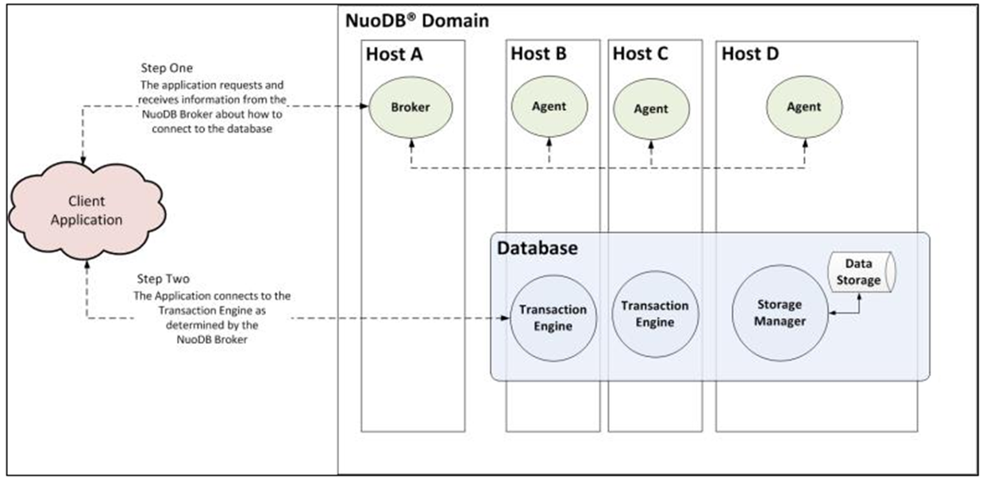
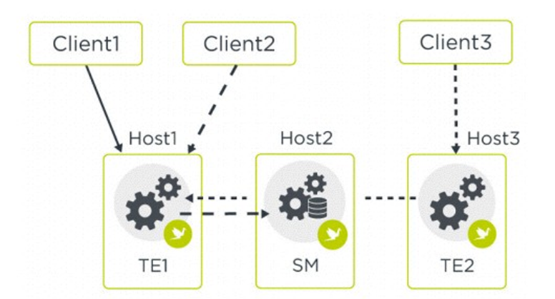

Slide 40
Conclusions
    NewSQL is an established trend with a number of options
❖
    Hard to pick one because they're not on a common scale No silver bullet
    Growing data volume requires ever more efficient ways to store and process it
❖
❖
❖

Slide 41

oldSQL, NoSQL and NewSQL: pros/cons
OldSQL
  +: proven techs and standard SQL, ACID
  +: rich client-side transaction
  +: established market
  -: not a scale-out architecture: single machine bottleneck
  -: complex management, tuning for performance
NoSQL
  +: higher availability and scalability
  +: support non-relational data, and OLAP
  -: fundamentally no ACID
  -: require application code; lack support for declarative queries
NewSQL
  +: stronger consistency and often full transaction support
  +: familiar SQL and standard tooling
  +: richer analytics using SQL and extensions
  +: leverages noSQL-style clustering
  -: no NewSQL is as general-purpose as traditional SQL systems
  -: in-memory architecture may hinder the application for large dataset
  -: partial access to the rich tooling of traditional SQL

Slide 42
An interesting resource
https://db-engines.com/en/ranking

